Slide 1
Ames Housing Price Prediction
Using linear regression to predict house prices in Ames, USA

Slide 2
Problem Statement
Using a regression model, this project aims to answer the following questions:
What features add the most value to a home, and which hurt home values the most?
What are features homeowners can add to increase the value of their home?
Given a set of features, what is the expected sale price of a house?
Given a budget, what kind of house would one be able to afford?
Data source: Kaggle

Slide 3
Exploratory Data Analysis (EDA)
During EDA, the main issues explored were:
Null values
Skewed distributions
Correlations and collinear features
Features with possible linear relationship with saleprice

Slide 4
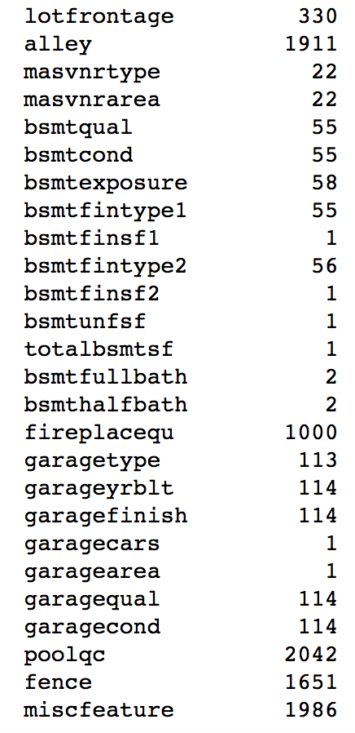
Some columns contained many null values
Feature name null count
Notes:
Most of the null values correspond to houses without a certain feature, e.g. pool, alley, basement

Slide 5
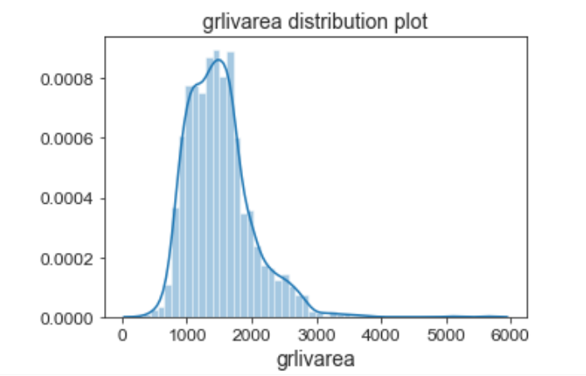
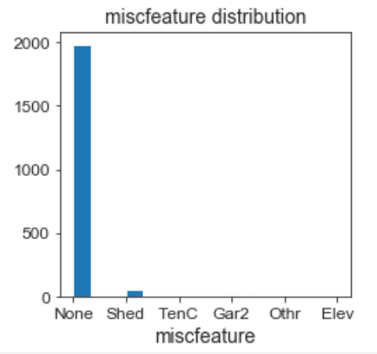
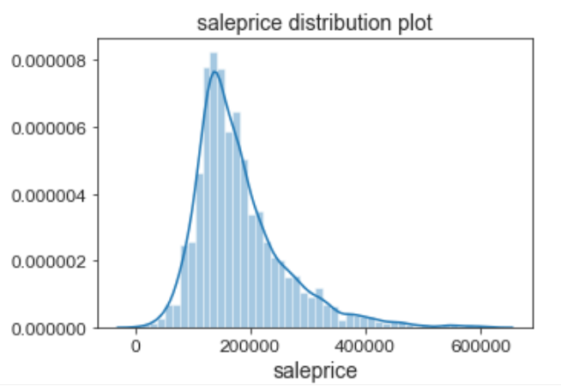
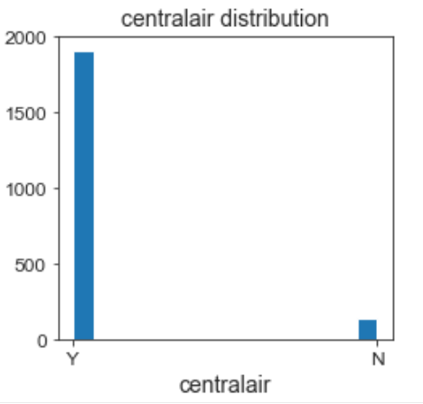
Some columns are heavily skewed towards one value
Notes:
These are examples of distribution plots of numerical features, and histograms of categorical features. They show the frequency of each value and each category so one can get a sense of the distribution.
Above grade living area (grlivarea) and saleprice are right skewed and have some houses that were bigger and more expensive than others. Most houses had no miscellaneous features, and almost all houses had centralair.

Slide 6
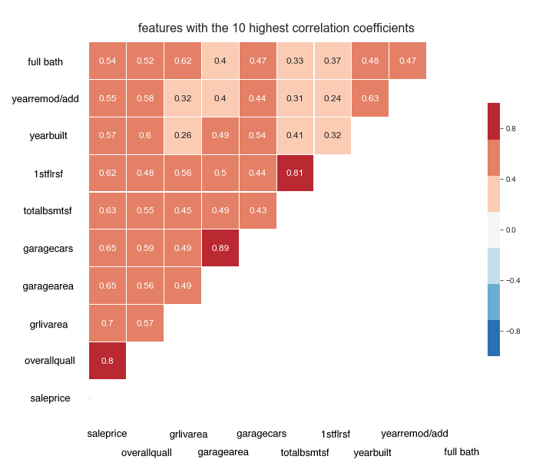
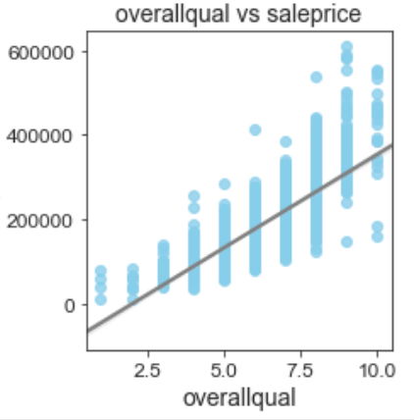
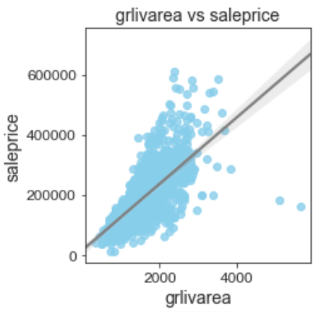
Notes:
This is a correlation heatmap of the 10 features that have the highest correlations with saleprice
Overallquall is the highest
There is also some collinearity, e.g. between garagecars and garagearea, and 1stflrsf and totalbsmtsf
Looking at the top 2 features specifically, there is quite an obvious linear relationship with saleprice

Slide 7
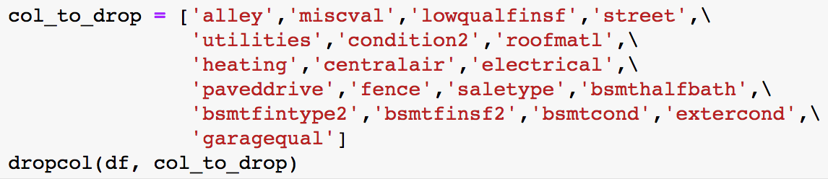
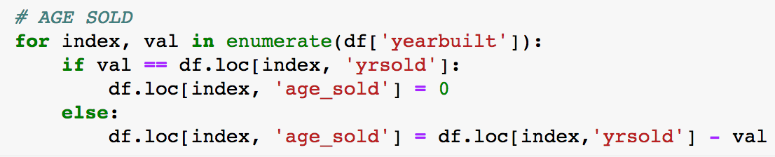
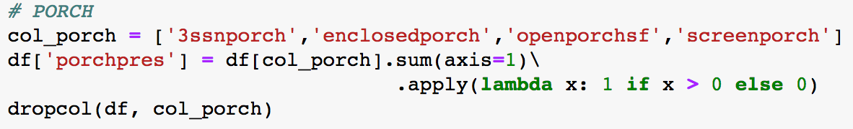
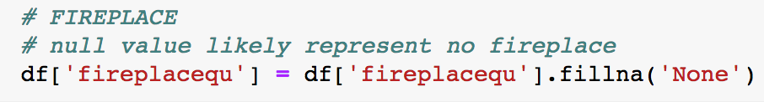
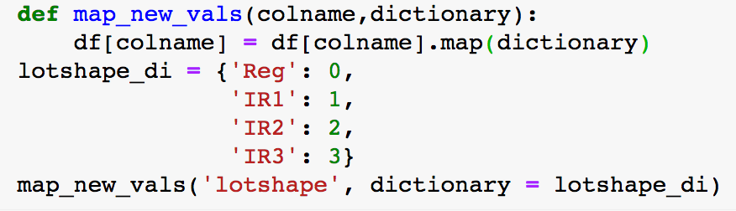
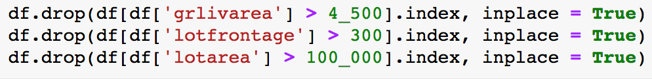
Preprocessing
1 | Drop columns with >80% zero or a single value | 4 | Add new columns
2 | Create ‘presence-absence’ columns | 5 | Impute missing values
3 | Convert ordinal to numerical | 6 | Remove outliers
Notes:
These are my main preprocessing steps.

Slide 8
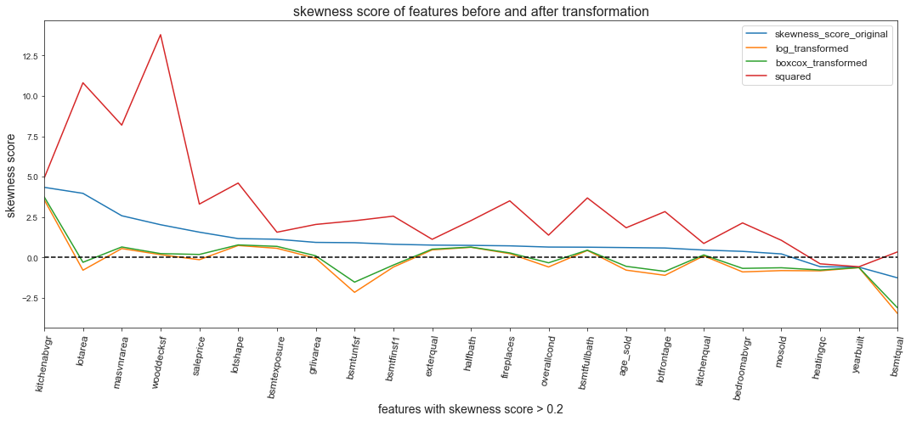
Transformation of the most skewed columns
Notes:
This shows the skewness score of the 20 most skewed features – the higher the score (on the left of the graph), the more skewed the feature is. A normal distribution have a score of 0, represented by the dotted line. A positive score (on the left of the graph) means right skew, and a negative score means left skew.
During preprocessing I also tried various methods to rectify the skewed distribution. The orange line – log transformation – generally did the best for right skewed features, while a square transformation did better for left skewed features.

Slide 9
Test performance
 | R² | RMSE
Baseline | -0.003 | 2.52
Simple linear regression | -1.103 | 26471299993
Ridge regression | 0.918 | 0.723
Lasso regression | 0.918 | 0.720
Elastic net regression | 0.919 | 0.719
Notes:
Regularised regressions all did better than the simple linear regression (which actually performed worse than the baseline, which just predicted the mean of the training data).
The elastic net model performed the best, with the highest R2 and the lowest RMSE.

Slide 10
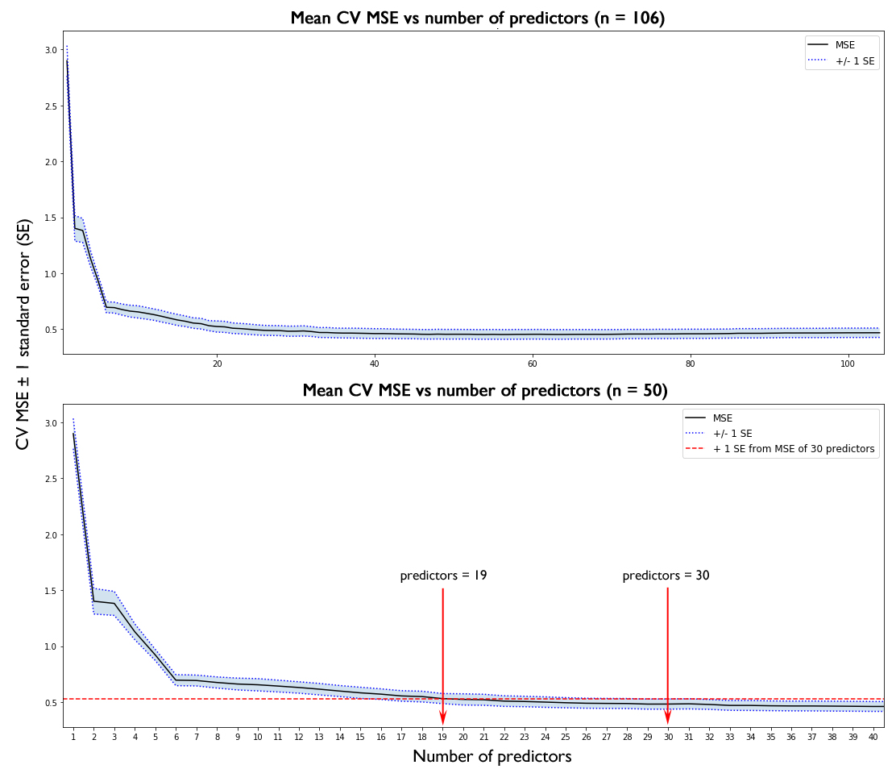
Feature selection
Notes:
These graphs plot the MSE against number of predictors. The top graph shows all 106 non-zero predictors, and the bottom graph zooms into the top 50 predictors to better visualise the trend. You can see that as the number of predictors in the model increases, MSE decreases.
MSE stops decreasing from about 30 predictors onwards
Going up one standard error from that point, we reach 19 predictors.

Slide 11
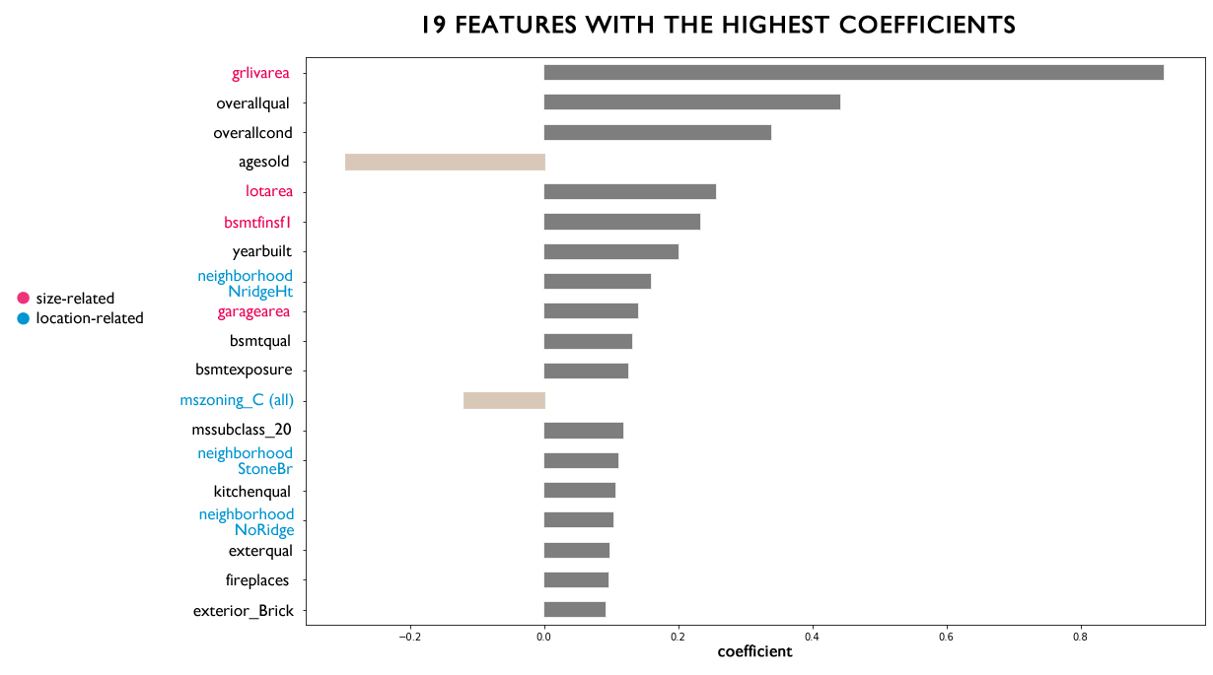
Notes:
And these are the 19 top predictors, in decreasing order of importance
You can first see that there are two features with negative coefficients –age of the house and mszoning C (commercial) are negatively correlated with sale price. As age increases, sale price decreases. And houses in the commercial zone are cheaper than other houses.
There are also a lot of size-related features (in pink), and location-related features (in blue). So the main things affecting house price is size and location.
If one wants to reduce the coefficients even further to make an even more easy to understand model, you can arguably just use the top 6 predictors. Because in the previous graph, there is an ‘elbow’ at 6, where MSE stops decreasing as quickly.

Slide 12
Recommendations
Square feet area, condition, age, and the location of the house are the most important determinant factors of sale price
House buyers should invest in Northridge Heights, Stone Brook, and Northridge
People looking to sell should do it sooner rather than later
To increase the value of a home:
Repaint/remodel the interior and exterior finish
Renovate the kitchen
Add a fireplace (if not already present)
Renovate the garage if it is in bad condition
Renovate the house if it had been severely damaged

Slide 13
Extra slides

Slide 14
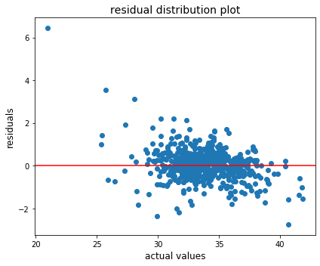
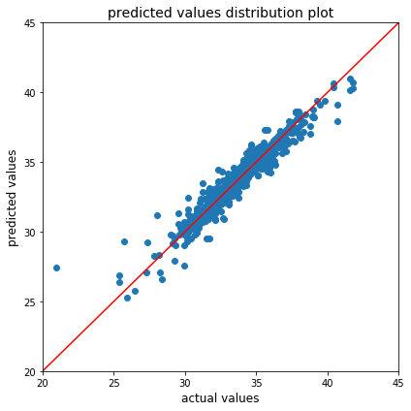
Residual plots

